Slide 1
NetApp Test Automation
Deepak Chandella

Slide 2

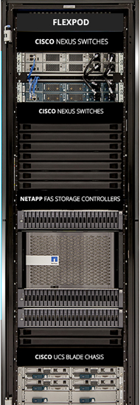



Netapp Automation use case: To check state of the disks
Create SSH Connection
with user credentials
Robot Framework
SSH Library
Custom Libraries
Execute command
“system node run -node initenasnoinc1a vol status –f” To check disk state
Config file
Test suites
---------------
Input params
Variables
Setup details
---------------
-------------
Access
Storage
Security
Connection
Netapp cluster in lab
Robot Setup
Get command output and verify that it should not have any broken disks
Verify test and
generate reports
and logs
Close SSH Connection

Slide 3





NetApp Automation flow via Jenkins
Robot Exec
Publish Reports
YAML File Sync
Reports
Fetch NetApp Test Cases
Master GIT
User
Jenkins Server
Upload YAML file with Setup details
Test Case Executions
Jenkins UI
NetApp Cluster
YAML File Sync
Email Stakeholders

Slide 4
Thank you ☺

